Slide 1
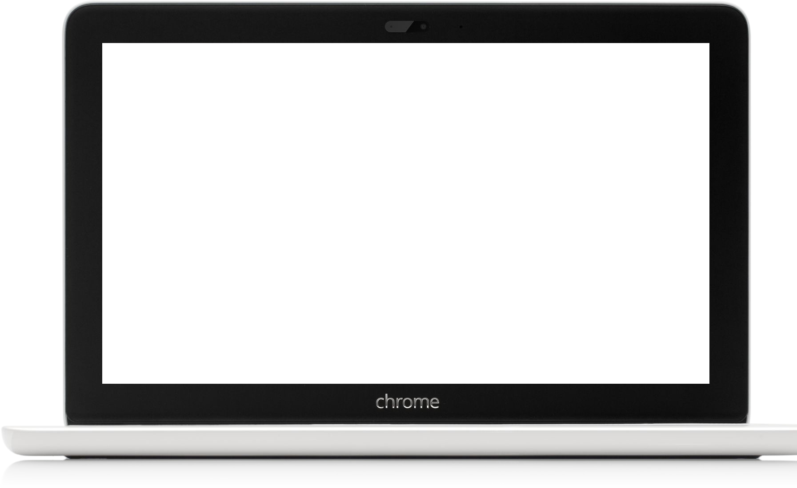
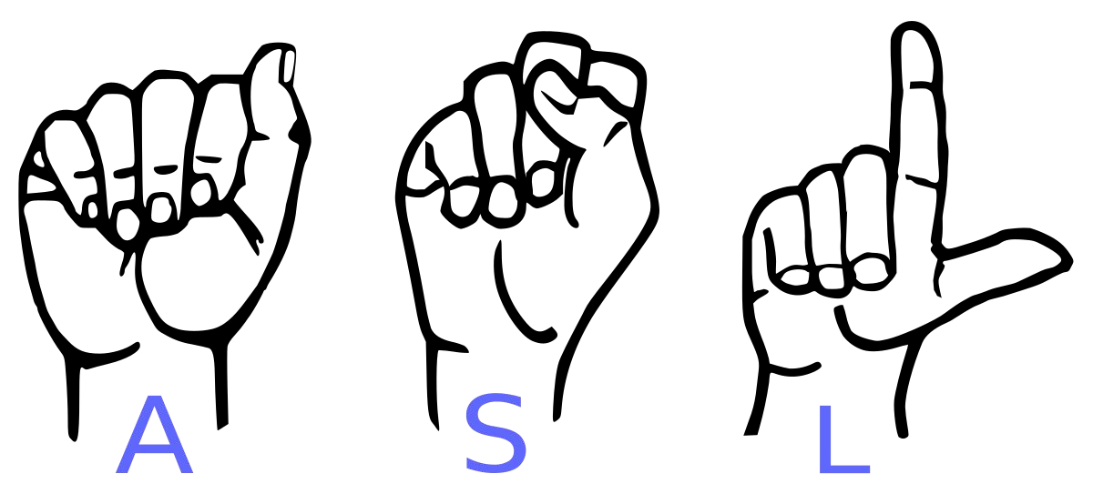
Sign Language
Detection using mediapipe

Slide 2

Abstract
The project aims to create a computer application and train a model which when shown a real time video of hand gestures of American Sign Language shows the output for that particular sign in text format on the screen.

Slide 3

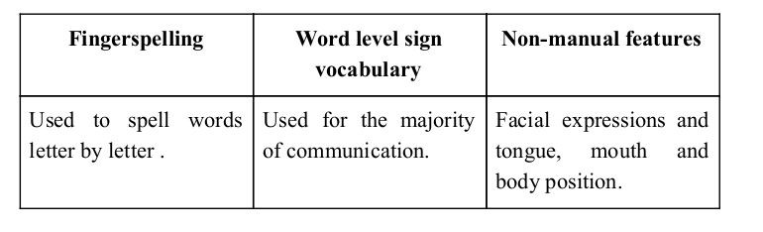
Sign language is a visual language and consists of 3 major components:

Slide 4
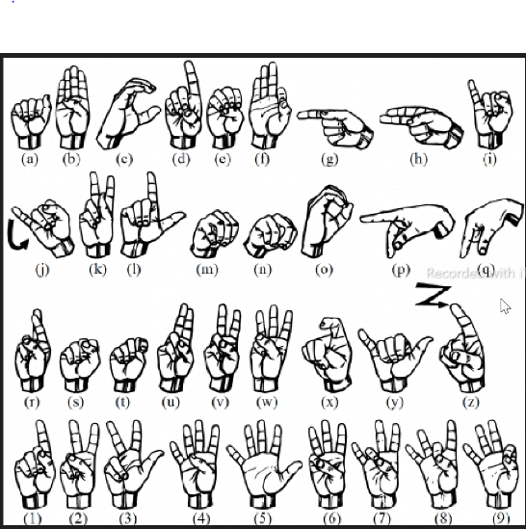
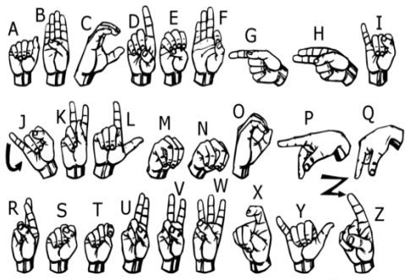
Implemented 27 symbols(A-Z, blank) of ASL in this project.

Slide 5
Methodology How to generated data set and did Data Preprocessing ?

Slide 6
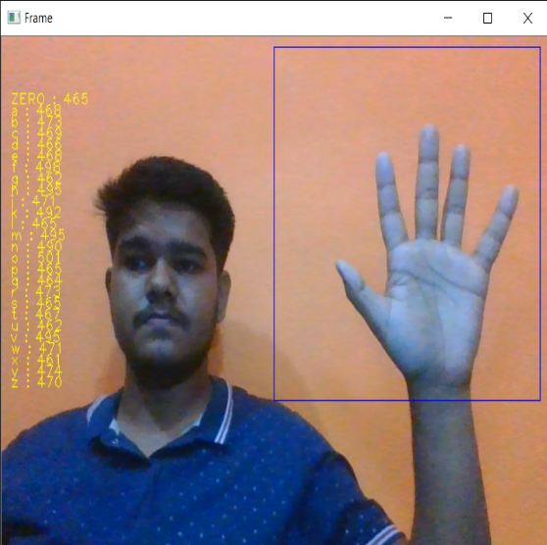
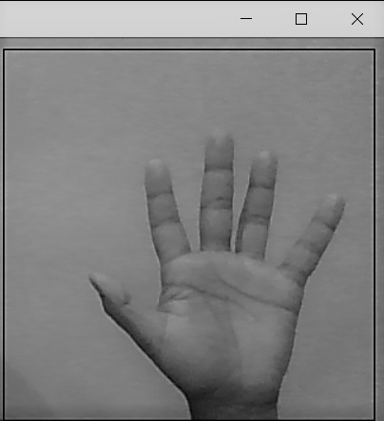
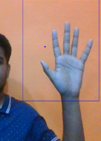
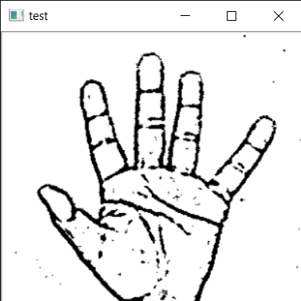
Image Post Gaussian Blur
Capturing Raw Image
Gray Scale Image

Slide 7
Gesture Classification

Slide 8
Layer 1
Layer 1
Classify between Similar Symbols
Classify between 27 Symbols

Slide 9
Algorithm Layer 1:
We detect various sets of symbols which show similar results on getting detected.
We then classify between those sets using classifiers made for those sets only.
In our testing we found that following symbols were not showing properly and were giving other symbols also :
For D
For U
For I
For S
: R and U
: D and R
: T, D, K and I
: M and N

Slide 10
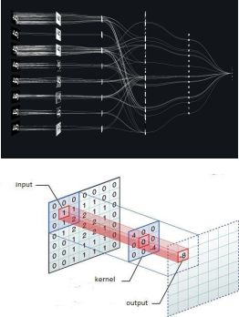
Convolutional Neural Networks
CNNs consist of multiple convolutional layers each layer containing numerous “filters” which perform feature extraction.
Initially these “filters” are random and by training, the feature extraction gets better by better.
It’s primarily used for image classification.

Slide 11
CNN Classifier Model

Slide 12
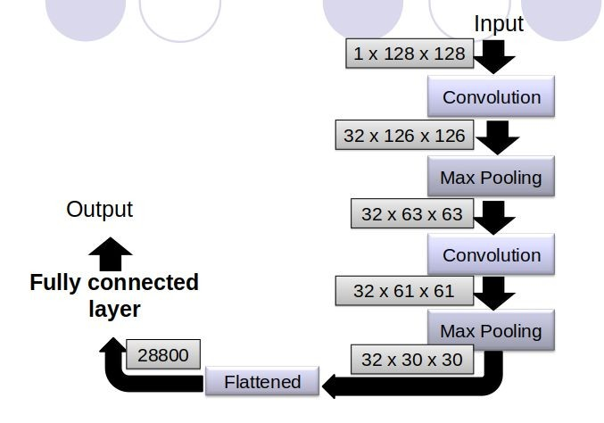

Slide 13
Software Requirements
Python 3.6.6
Tensorflow 1.11.0
OpenCV 3.4.3.18
NumPy 1.15.3
Matplotlib 3.0.0
Keras 2.2.1

Slide 14
Limitations of our model
The model works well only in good lighting conditions.
Plain background is needed for the model to detect with accuracy.

Slide 15
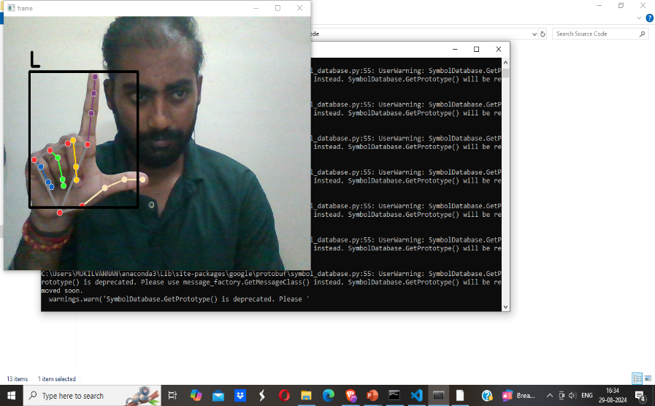
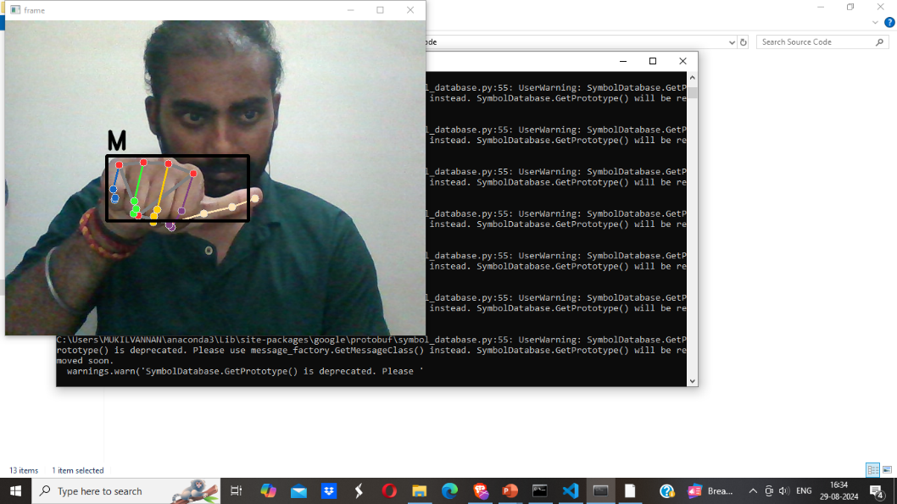
Results

Slide 16
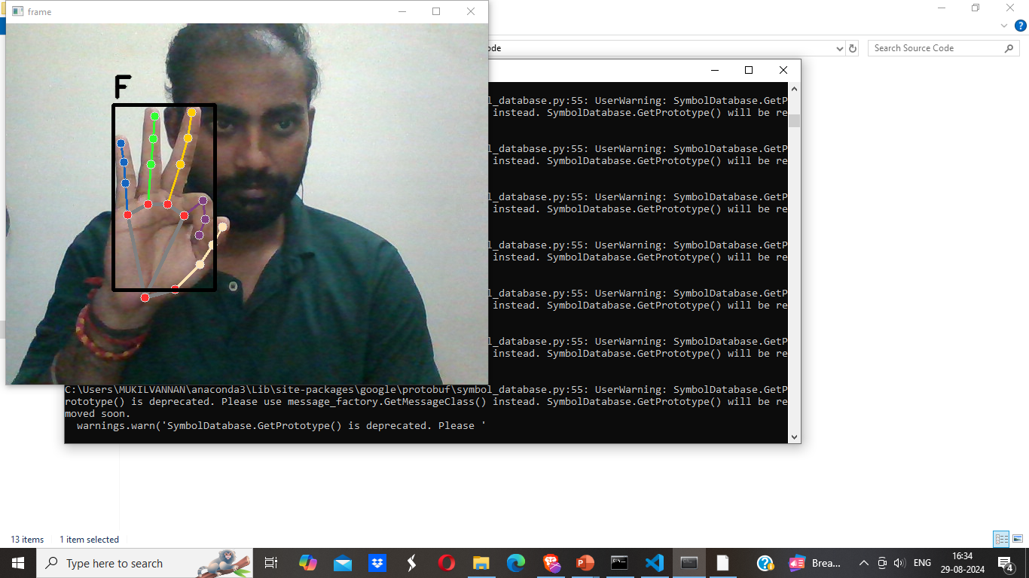
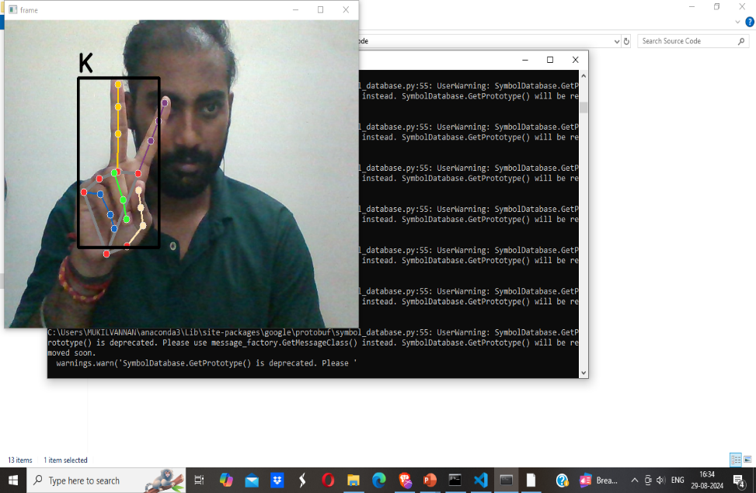

Slide 17
Conclusion
In this report, a functional real time vision based american sign language recognition for D&M people have been developed for asl alphabets.
I achieved an accuracy of 98.00% on our dataset.
Prediction has been improved after implementing two layers of algorithms in which we verify and predict symbols which are more similar to each other.

Slide 18
Challenges faced
A functional real time vision based american sign language recognition for D&M people sometimes its not working for own created datasets.
But we can also use other hand gesture dataset for this problem because it can be rectified using the efficiency of mediapipe and OpenCV .

Slide 19
Future Scope
Am planning to achieve higher accuracy even in case of complex backgrounds by trying out various background subtraction algorithms.
Am also thinking of improving the preprocessing to predict gestures in low light conditions with a higher accuracy.

Slide 20
*Z. A. Ansari and G. Harit. (2016) "Nearest neighbour classification of Indian sign language gestures using Kinect camera," Sadhana, vol. 41, p. 161–182
*N. M. Kakoty and M. D. Sharma. (2018) "Recognition of sign language alphabets and numbers based on hand kinematics using a data glove," Procedia Computer Science, vol. 133, p. 55–62
Reference based on books

Slide 21
Thank You !

